Slide 1


Intern & Placement Office
Management(IPOM)
Submitted As,
SRS Document Presentation
Midterm 1
Course: SE 503
Supervised By,
Dr. Zerina Begum
Professor
IIT, Du
Team Members
Mahir Faisal BSSE-1316
Mostafizur Rahaman Rakib BSSE-1320

Slide 2


WHY IPOM ?

Slide 3
Language & Tools
HTML
CSS
Java Script
React js
(Front-End)

Slide 4
Language & Tools
Node js
Express
Mongodb
(Back-End)

Slide 5



Agenda
Requirement Collection
Software Requirement Specification(SRS) of the IPOM
Development Progress
Github repository link

Slide 6
Requirement Collection
Normal requirements according to IPO Committee
member
➣ Student, IPO head, IPO coordinator & company HR will sign up & sign in their accounts.
➣ Anyone with the permission of authority can be the head of the IPOC.
➣ IPOC coordinator can enter the intern taking company names, available intern positions, the job responsibilities of each position with company address and HR’s email address.
➣ IPOC coordinator can inform the student to upload their CV.
➣ IPO head has the authority to allocate any student to any company.

Slide 7

Requirement Collection(cont.)
Expected requirements according to IPO Committee
member
➣ Student can upload their CV.
➣ Student also can upload their Skill set & CGPA.
➣ IPOC member can suggest the student list.
➣ IPO head can allocate students.
➣ Student & IPOC can view the current status.
➣ The IPOC coordinator can utilize Skill Set as search criteria, enabling the system to display the targeted list of students.

Slide 8
Requirement Collection(cont.)
Exciting requirements according to IPO Committee
member
➣ Auto-generated Admit card.
➣ System can send email to the student.
➣ Auto-generated formal letter.
➣ A mapping system may be available to illustrate the route and distance between the student's address and the company.

Slide 9
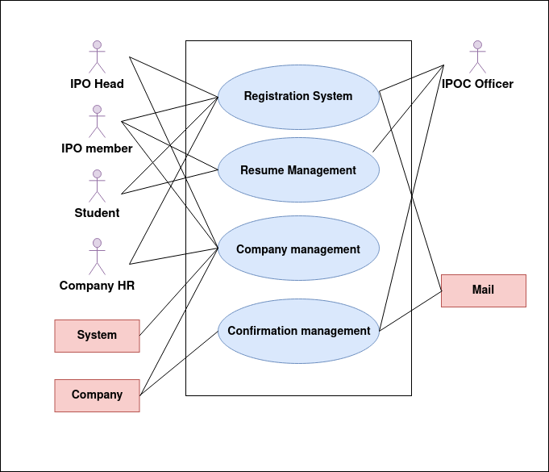
SRS
Use Case Diagram
Level: 1 & 1.2

Slide 10
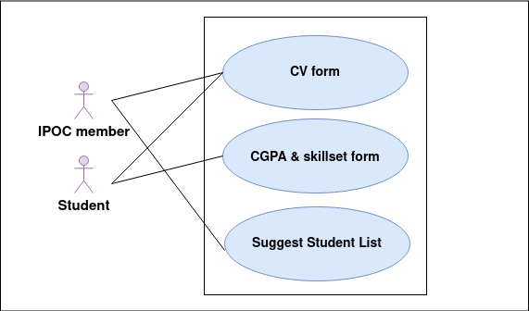
SRS
Use Case Diagram
Level: 1 & 1.2

Slide 11
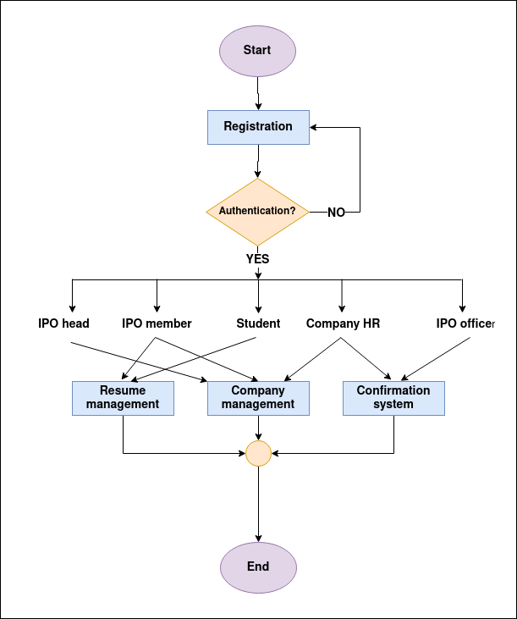
SRS(continued)
Activity Diagram
Level: 1

Slide 12
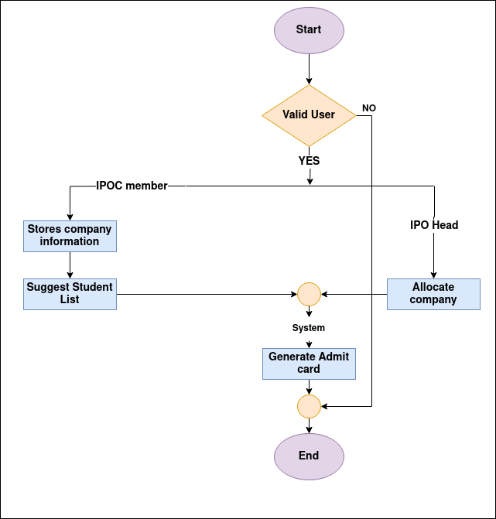
SRS(continued)
Activity Diagram
Level: 1.3

Slide 13
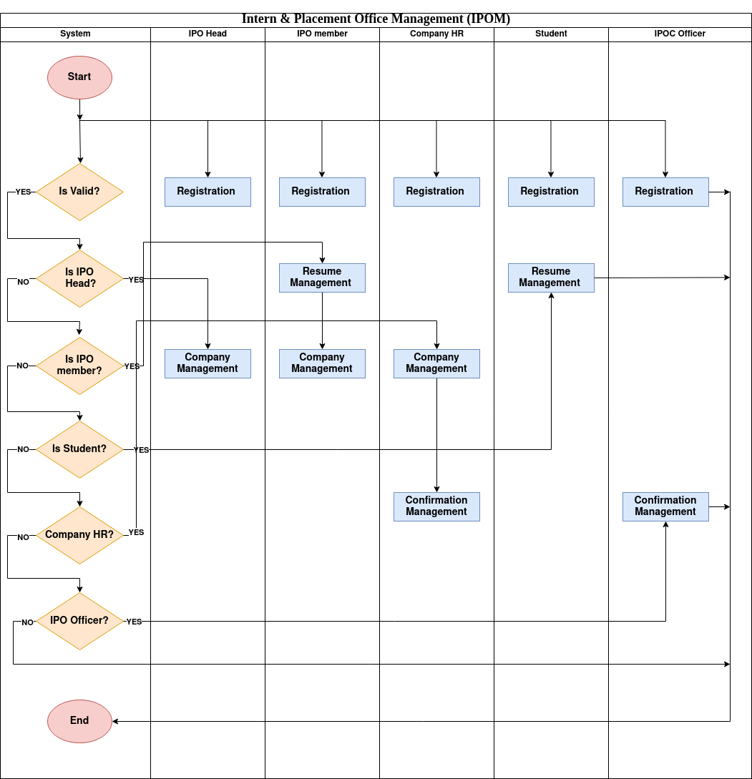
SRS(continued)
Swimlane Diagram
Level: 1

Slide 14
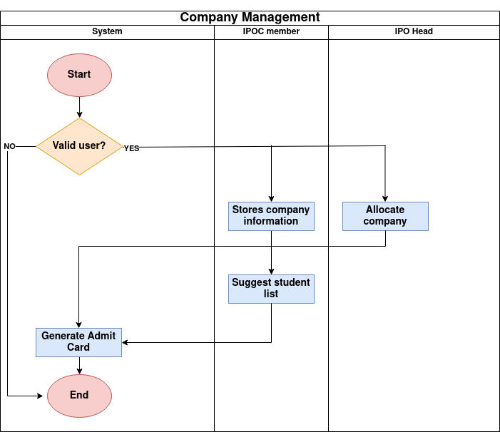
SRS(continued)
Swimlane Diagram
Level: 1.3

Slide 15
Class Based Modeling
SRS(continued)
Noun and Verb List Identification
Selection Criteria
Analysis
1
3
5
2
4
6
General Classification
Attribute and Method Distribution
Class Cards

Slide 16
Class-Based Modeling (Cont.)
General Classification
External entities
Things
Occurrences or events
Roles
Organizational units
Places
Structures
Selection Criteria
Retain information
Needed services
Multiple attributes
Common attributes
Common operations
Essential requirements

Slide 17
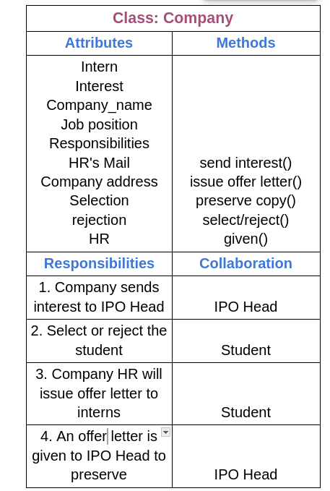
Class Cards
Class-Based Modeling (Cont.)
Final Classes After Analysis
Final Classes
IPOC
Company
IPO Head
Student
System
IPOC Officer
Dashboard

Slide 18
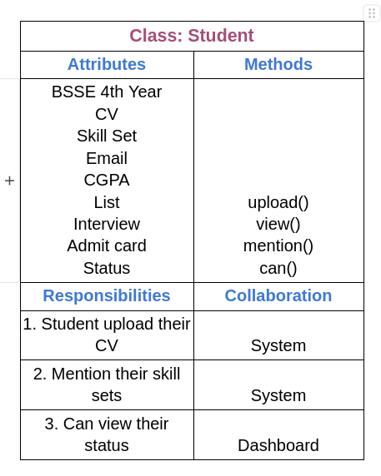
Class Cards
Class-Based Modeling (Cont.)
Final Classes After Analysis
Final Classes
IPOC
Company
IPO Head
Student
System
IPOC Officer
Dashboard

Slide 19
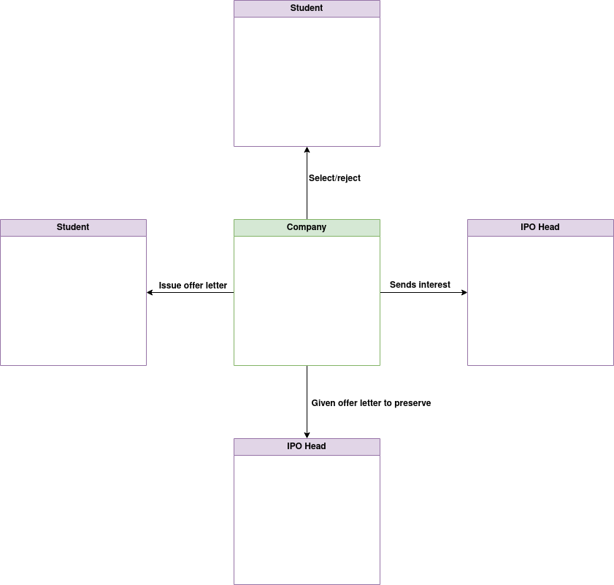
CRC Diagram
Class-Based Modeling (Cont.)

Slide 20
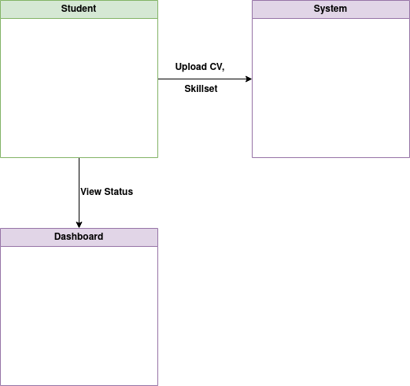
CRC Diagram
Class-Based Modeling (Cont.)

Slide 21
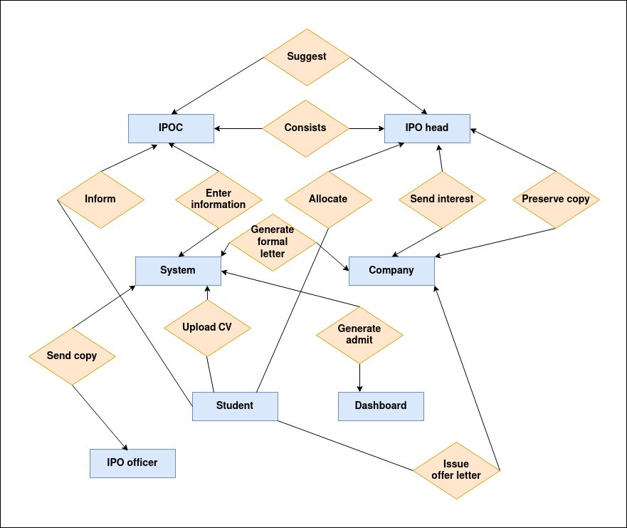
SRS(continued)
ER diagram:

Slide 22
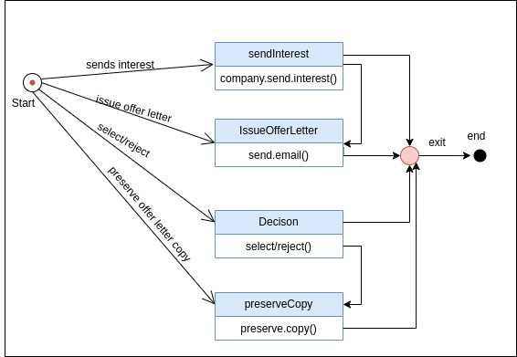
Behavioral Modeling
ID: 2
Name: Company

Slide 23
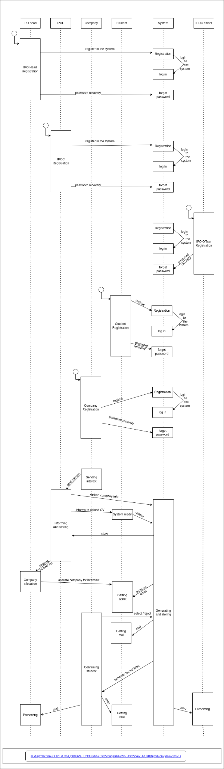
Flow Oriented Modeling
Sequence Diagram

Slide 24
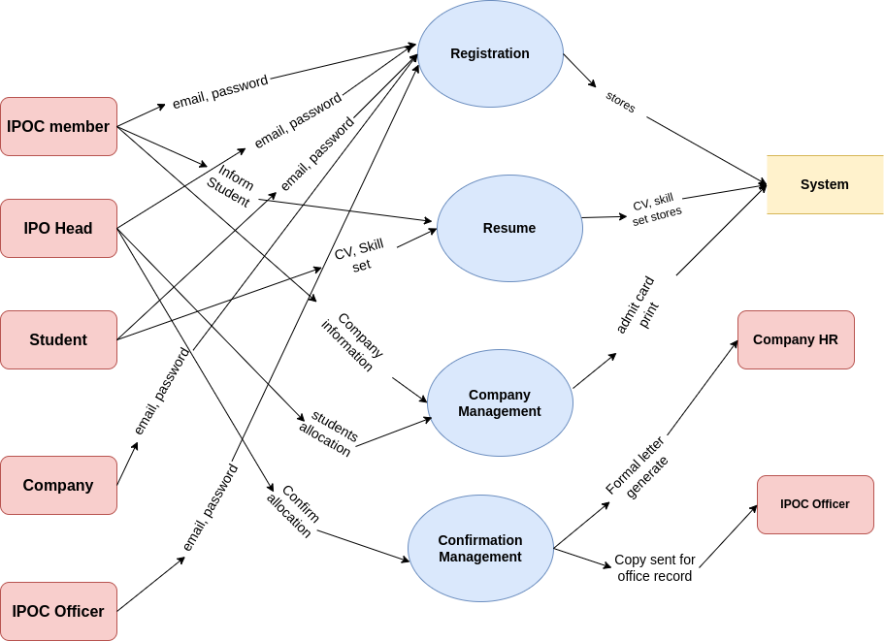
Data Flow
Level: 1
Name: Details IPOM

Slide 25
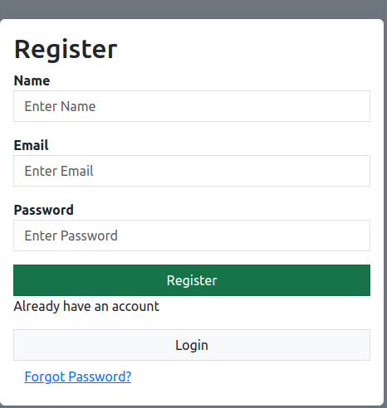
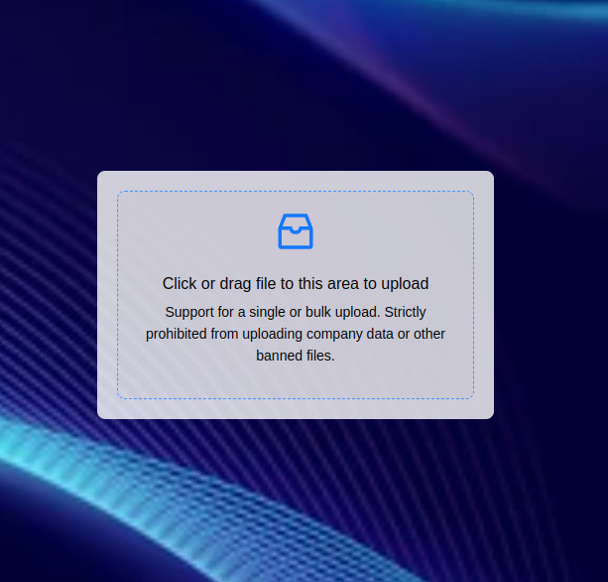

Progress so far
Completed authentication part both of front and back end.
Design landing page
Developed drag & drop option

Slide 26
Github Repository Link
https://github.com/MdMostafizurRahaman/SPL-II

Slide 27
Thank You

